Slide 1
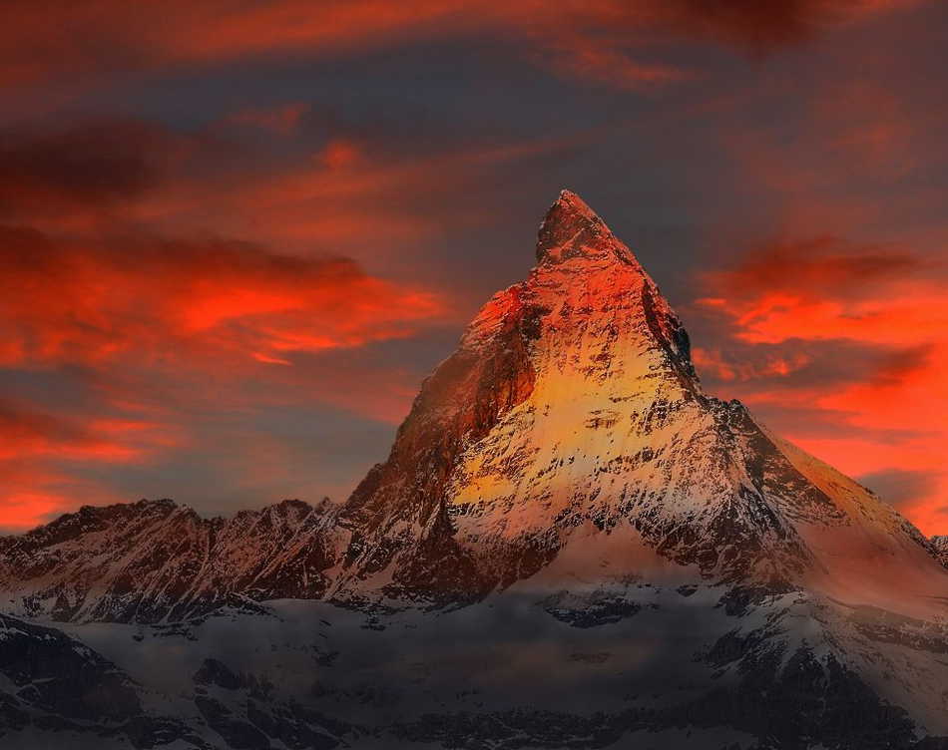
Hymn of Heaven

Slide 2
How I long to breathe the air of Heaven
Where pain is gone
and mercy fills the streets

Slide 3
To look upon the one who bled to save me
And walk with Him for all eternity

Slide 4
There will be a day
When all will bow before Him
There will be a day
When death will be no more

Slide 5
Standing face to face
With He who died and rose again
Holy holy is the Lord

Slide 6
Every prayer we prayed in desperation
The songs of faith
We sang through doubt and fear

Slide 7
In the end we’ll see that it was worth it
When He returns to
wipe away our tears

Slide 8
There will be a day
When all will bow before Him
There will be a day
When death will be no more

Slide 9
Standing face to face
With He who died and rose again
Holy holy is the Lord

Slide 10
On that day we join the resurrection
And stand beside the heroes of the faith

Slide 11
With one voice a thousand generations
Sing worthy is the Lamb who was slain

Slide 12
On that day we join the resurrection
And stand beside the heroes of the faith

Slide 13
With one voice a thousand generations
Sing worthy is the Lamb who was slain
Forever He shall reign

Slide 14
So let it be today
We shout the hymn of Heaven
With angels and the Saints
We raise a mighty roar

Slide 15
Glory to our God
Who gave us life beyond the grave
Holy holy is the Lord

Slide 16
So let it be today
We shout the hymn of Heaven
With angels and the Saints
We raise a mighty roar

Slide 17
Glory to our God
Who gave us life beyond the grave
Holy holy is the Lord
Holy holy is the Lord
Holy holy is the Lord

Slide 18
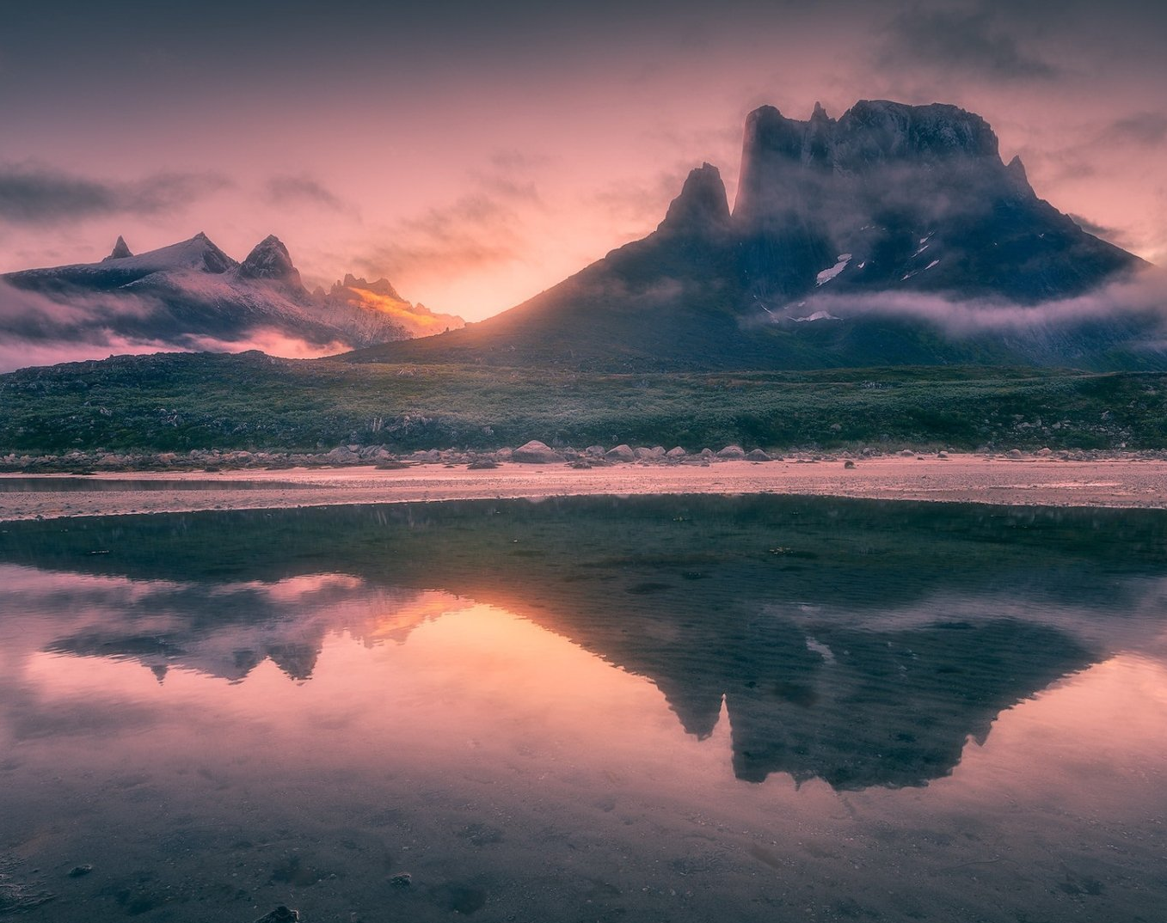
His Mercy is More

Slide 19
What love could remember,
no wrongs we have done
Omniscient all-knowing,
He counts not their sum

Slide 20
Thrown into a sea,
without bottom or shore
Our sins they are many,
His mercy is more

Slide 21
What patience would wait as we
constantly roam
What Father so tender
is calling us home

Slide 22
He welcomes the weakest,
the vilest, the poor
Our sins they are many,
His mercy is more

Slide 23
What riches of kindness
He lavished on us
His blood was the payment,
His life was the cost

Slide 24
We stood 'neath a debt
we could never afford
Our sins they are many,
His mercy is more

Slide 25
Praise the Lord,
His mercy is more
Stronger than darkness,
new every morn

Slide 26
Our sins they are many,
His mercy is more
Our sins they are many,
His mercy is more

Slide 27
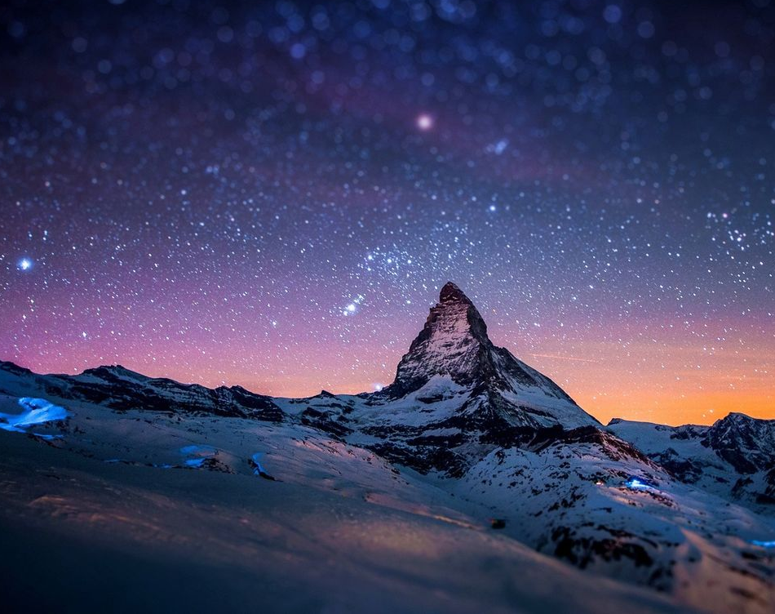
All sufficient merit

Slide 28
All sufficient merit
Shining like the sun
A fortune I inherit
By no work I have done

Slide 29
My righteousness I forfeit
At my saviors cross
Where all sufficient merit
Did what I could not

Slide 30
In love he condescended
Eternal now in time
A life without a blemish
The maker made to die

Slide 31
The Law could never save us
Our lawlessness had won
Until the pure and spotless
Lamb had finally come

Slide 32
It is done
It is finished
No more debt I owe

Slide 33
Paid in full
All sufficient merit now my own

Slide 34
I lay down my garments
Any empty boast
Good works now all corrupted
By the sinful host

Slide 35
I’m dressed in my LORD Jesus
A crimson robe made white
No more fear of judgement
His righteousness is mine

Slide 36
It is done
It is finished
No more debt I owe

Slide 37
Paid in full
All sufficient merit now my own

Slide 38
All sufficient merit
Firm in life and death
The joy of my salvation
Shall be my final breath

Slide 39
When I stand accepted
Before the throne of God
I’ll gaze upon my Jesus
And thank Him for the cross
Yes I’ll thank Him for the cross

Slide 40
It is done
It is finished
No more debt I owe

Slide 41
Paid in full
All sufficient merit now my own
(Oh your merit now my own)

